Slide 1
Working with the new AEM Assets View
Notes:
Before we dive in, please note the important legal information presented here.
The content we'll cover is intended only for those enrolled in this training - so you!
Please do not record, reproduce, or share this material, including any URLs or account information.
Adobe makes every effort to provide accurate and up-to-date content, but always refer to the latest official documentation for any updates - Assets View is moving fast and it is very difficult for everyone - us included, to keep up.
Let's ensure we respect these guidelines throughout the course.

Slide 3
Instructor

Slide 4


My name
My company & role
Notes:
Let’s make something short as accelerator needs to be straight to the point

Slide 5
Legal and Confidentiality Information
© 2025 Adobe, Inc. All rights reserved.
Every effort was made to ensure that the information in this document was complete and accurate at the time of publication. However, information is subject to change and Adobe cannot assume responsibility for any errors or omissions. Changes or corrections to the information contained in this document may be incorporated in future issues.
This copyrighted document along with other materials for this course may not be recorded, reproduced, duplicated, reverse engineered, or adapted.
Training is intended only for those individuals who have registered and paid for it; training access URLs, user names and passwords, or access of any kind may not be shared.
This document and other materials for this course are Adobe confidential and proprietary information which must be retained in confidence by the recipient.
Notes:
(iBefore we dive in, please note the important legal information presented here.
The content we'll cover is intended only for those enrolled in this training - so you!
Please do not record, reproduce, or share this material, including any URLs or account information.
Adobe makes every effort to provide accurate and up-to-date content, but always refer to the latest official documentation for any updates - Assets View is moving fast and it is very difficult for everyone - us included, to keep up.
Let's ensure we respect these guidelines throughout the course.

Slide 6
Course Agenda
Module | Name
1 | Essential Knowledge in Two Slides!
2 | UI Foundations
3 | Metadata
4 | Access Control
5 | Customization
6 | Insights
7 | Takeaways and Questions

Slide 7
Essential Knowledge in two slides!
Notes:
I'll start with the essential information needed to understand the 2025 Adobe assets landscape. What _Assets View_, _Assets Essentials_ and _Admin View_ are, and a look at the future.

Slide 8


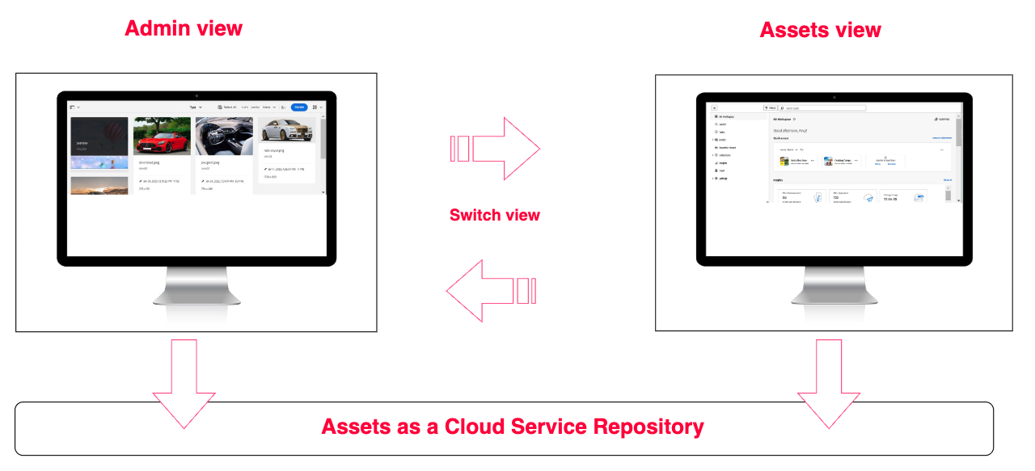
The two UIs - Admin View and Assets View
Notes:
Here you see the two user interfaces for managing assets in AEM: Admin View on the left, and Assets View on the right.
You may previously have known Admin View simply as AEM Assets—this is the classic Touch UI dashboard for managing your digital assets. Throughout today’s training, whenever we refer to the “Admin View,” we mean this familiar interface that most of you have used or have referred to in the past as just AEM.
Assets View is the new cloud-hosted, React-based interface, designed to be a streamlined and modern experience. It’s accessible from the Experience Cloud homepage, via the Experience Cloud header, or by switching from Admin View—as shown by the “switch” arrow on this slide.
Both interfaces connect you to the same repository of digital assets, including all your metadata and enterprise features like advanced access control. The difference is in the user experience and tools each offers.
While Assets View is rapidly evolving and gaining new capabilities every month, Admin View remains essential for tasks requiring deeper administrative controls and advanced management options.
Both views share core features—such as uploading, searching, asset metadata management, and simplified access controls. At the same time, each has unique capabilities suiting different user roles and requirements.
A quick note: This is a fast-changing landscape! Since work on this course began in June, Assets View has received significant new features and updates nearly every month. Adobe Engineering, Consulting, and Solution Partners are working live with customers to discover requirements and deliver improvements—sometimes on the bleeding edge. What we cover today reflect, to the best of my knowledge, the November release, but we may still find a surprise or two!
You may have noticed a cog icon next to the words Admin View, and an Assets Icon next to the Assets View. I have added these to other slides in the presentation to remind you which View we are discussing at any point.
So, where is this strange mixed system going? Let’s take a look into the future!

Slide 9
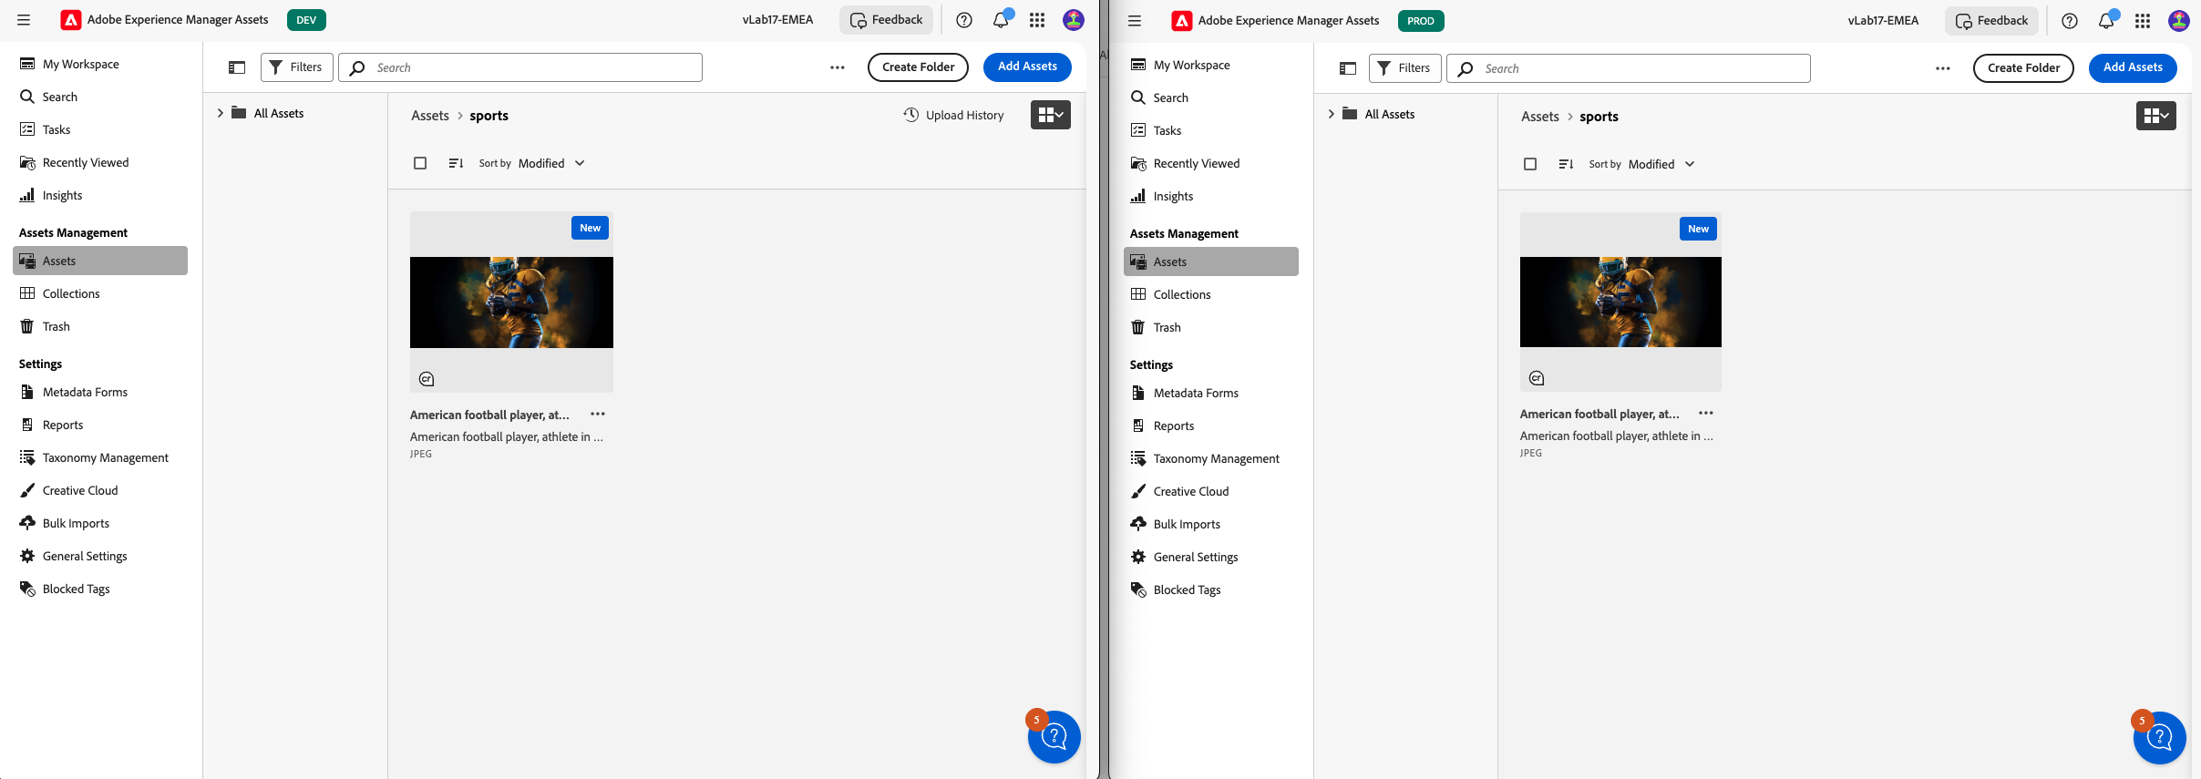

Assets and Assets Essentials
AEM Dev
AEM Stage
AEM Prod
AEM Prod
Notes:
Now another clarification about the new AEM Assets landscape. You may have heard of Assets Essentials. If you've ever looked at the documentation or interface, you may have been confused about Assets Essentials versus Assets. I'd like to address that right at the start and be sure that you know which system we will be working with today.
As you can see the side-by-side screenshots of the two systems on the slide, full AEM Assets on the left, and Assets Essentials on the right, appear to be near identical, even though they have very different capabilities.
The key difference is in the backend. AEM Assets View on the left is the new interface for a full AEM Assets program to which you have full access. So enterprise level Assets management.
Assets Essentials on the right is also based on AEM, but it's a single production instance to which you have no access. The result is a lightweight asset management system without the full enterprise features of AEM.
From the perspective of the assets contributors and consumers that use the systems, there may be little difference, but for an enterprise and its admins and power users, the systems meet different use cases and are very different.
In this course we are going to work with full AEM Assets, and will not consider essentials further.

Slide 10


The Future
“Assets View” is the future “Assets”
Customers recommended to adopt Assets View for future-proofing
New features likely to be only available in Assets View,. Current example: Dynamic Media template editor
Admin View still supported and no sunset
“Assets View” is the future “Assets”
Notes:
Where possible customers are encouraged to adopt Assets View for future-proofing.
New features and innovations — such as _Dynamic Media Templates_ for real-time personalization — are launching exclusively in Assets View. Also admin and configuration features will be added to Assets View as we move towards feature parity.
Product feedback on gaps or workflows is encouraged by Adobe and shapes ongoing development priorities.
Admin View (Touch UI) is still essential and continues to be supported. There is no end of life date.
The future of assets is in Assets View, with ContentHub as the asset distribution portal.

Slide 11
Today’s Training

Slide 12
This Course –What you’ll Learn
Use the basic features of the new Assets View UI
Understand metadata and use it in search
Configure permissions in Assets and Admin View
We’ll discuss the search-first, metadata-first paradigm
Use Assets View productivity tools and insights
Discuss asset distribution channels
Understand simplified access control
Understand customization possibilities
Notes:
- Learn how to use the essential functions of the new Assets View interface
- See what’s new in Assets View and how it differs from Admin View
- Work with metadata in Assets View, including editing and management tasks
- Configure permissions in both Assets View and Admin View
- Understand customization features for Assets View
- Understand the analytics and insights available in Assets View

Slide 13
UI Foundations: Concepts and Usage
Notes:
Let’s take a moment to cover the fundamental concepts and usage of the two UIs, starting with Assets View.

Slide 14

Quick Facts – Assets View
More modern, responsive UI
Shared between environments (select repository from available environments)
AEMaaCS only
Easy adoption for those wilth AEM Assets experience
Fewer configuration and customization options than Admin View.
Notes:
Assets View is built with a modern, responsive UI that’s unified across your different AEM environments—you just select the right environment
It’s available only in AEM as a Cloud Service. You cannot use Assets View with on-premise or managed service AEM.
For most users, adoption is straightforward—the UI is easy to learn and use right away, and, if you’ve used AEM Assets before, by the end of this short course you will understand and be ready to use almost all of its features. If you haven’t used assets before, you may fight one or two things mysterious but will be nonetheless ewady to go.
You don't have as many customization and configuration option as you do in assets view. You have less access to the underlying code.

Slide 15

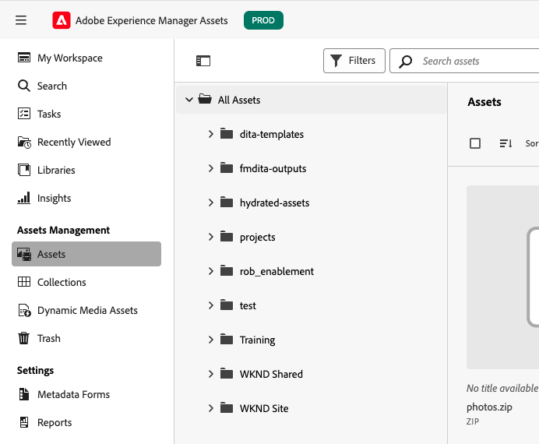
Use Assets View when…
Work in a marketer-friendly interface
Quickly find, annotate, download, collect, and share assets
Leverage workspace insights, pinning, and notifications
Apply/administer permissions at a basic level or need workspace/insights dashboards
Use smart crop and DM renditions (for configured assets)
Using new Dynamic Media templates
Notes:
Use Assets View when
- you want a marketer-friendly interface that makes collaboration, searching, and gaining insights simple.
- you need to quickly find, annotate, download, collect, and share assets—without extra steps.
- Take advantage of workspace insights, pinning, and notification features to stay organized and informed.
- If you’re applying or managing permissions at a basic level
- And if your asset workflow includes smart crop or Dynamic Media previews, you’ll find these built right in and easily accessible.
For creative, marketing, and business teams, Assets View supports efficient, intuitive asset management.

Slide 16
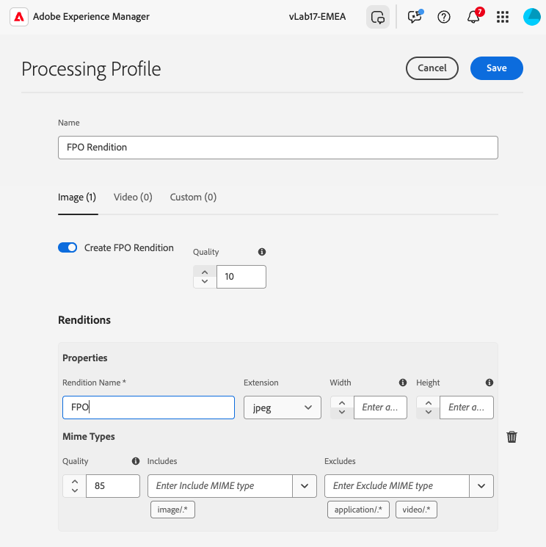
Use Admin View when….
Configuring advanced DAM settings
Managing processing profiles and custom renditions
Performing bulk operations like metadata import/export
Assigning granular permissions and user roles
Building or controlling custom workflows and workflow models
Generating comprehensive asset and system reports
Integrating with automation or specialized systems
Notes:
Let’s look at when you’ll need to rely on Admin View.
If you’re configuring advanced digital asset management settings—like Dynamic Media processing, complex metadata schemas, or handling complex processing profiles and custom renditions—Admin View is required.
It’s your go-to for bulk operations, such as importing and exporting large sets of metadata, or when you need to assign granular permissions and manage detailed user roles.
For building and maintaining custom workflows, or for complex workflow models that support your business automation, Admin View offers the necessary tools and flexibility.
And when you need to generate comprehensive reports on asset activities or system status, these capabilities are part of Admin View.
In short, whenever your work calls for deep administrative control, technical configuration, or advanced integration, Admin View remains essential—even as Assets View takes on a more central role for day-to-day tasks.

Slide 17
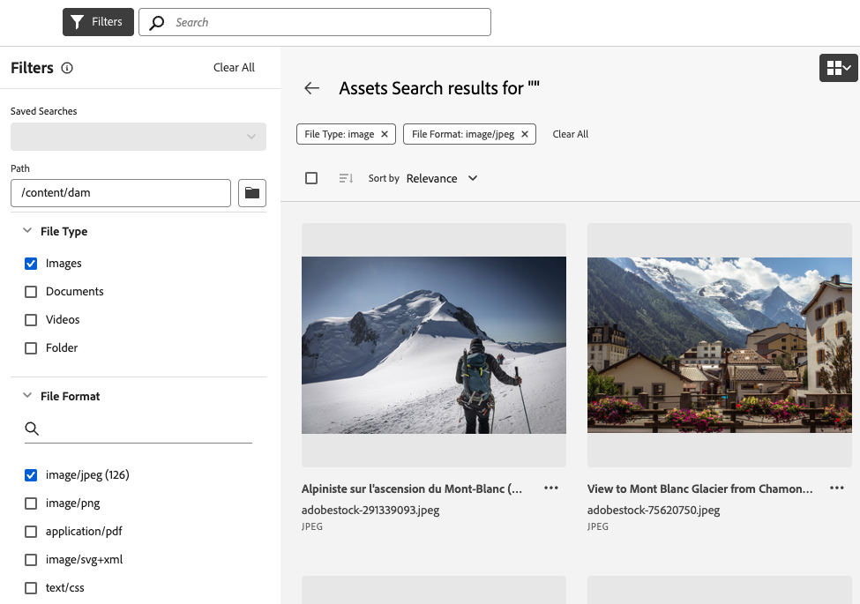
Search first: Metadata instead of Folder structure
Search and metadata are the starting point
Search bar and filters always visible
Metadata drives all results
Folder navigation is secondary
AI and Smart Tags need metadata
Scales with fast asset discovery
Find by describing, not by remembering locations
Notes:
In Assets View, search and metadata filtering are the primary ways to discover assets.
Instead of relying on complicated folder structures, users start by entering keywords or applying filters — so search enabled by metadata is front and center in every workflow.
The search bar and filters are therefore always visible—it’s the main way users interact with assets.
Asset metadata like titles, tags, dates, and usage rights drive the results, ensuring you get what you need quickly.
Browsing folders is still possible, but it’s secondary; the interface encourages searching instead of clicking through folders.
Features like Smart Tags and AI-powered visual search work best when assets have rich metadata.
A meta-data first approach is scalable. Using a folder structure to organize assets has practical limits in organizing large number of assets.
You don’t need to remember where a file lives—just describe what you need, and let the metadata guide you.
Summary:
Assets View is “search-first” because search isn’t just powerful—it’s the main method of finding, organizing, and working with assets. Metadata is the foundation, and search is the entryway.

Slide 18
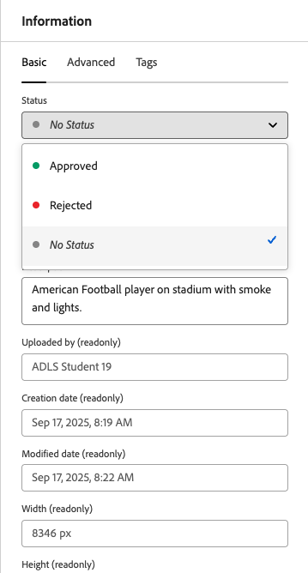
Approval and Publishing
Publishing activates assets for AEM Publish and (Scene7) Dynamic Media
Setting Approved is a governance best practice
Classic Dynamic Media (Scene7) serves any published asset, regardless of approval status
Approval is enforced only for Content Hub & Dynamic Media Open API delivery
Publish = visibility; Approve = control for new delivery channels
Notes:
In AEM Assets View, **publishing** and **approval** both play vital, but different, roles in how assets reach their audiences.
Publishing is what moves assets from the Author environment to AEM Publish, making them available on websites and portals such as Asset Share Commons.
Approval status is a separate metadata step. The approval dialog in AEM Assets View is shown in the screenshot on the right.
Setting an asset to "Approved" in Assets View helps maintain governance and content oversight. The approval status is also accessible in the Admin View, but it is somewhat hidden in the metadata dialogs, not the core, high-profile feature that we see in Assets View.
However, for traditional AEM Publish and classic Dynamic Media, this approval field does not restrict access—any asset that is published will be available, regardless of approval status.
In the newer delivery models—like Content Hub and Dynamic Media Open API—approval status is required: only approved assets are exposed through those APIs and public endpoints.
So, while publishing is what controls visibility in classic AEM Publish and Dynamic Media, approval gating is enforced only for modern delivery servers and APIs.

Slide 19
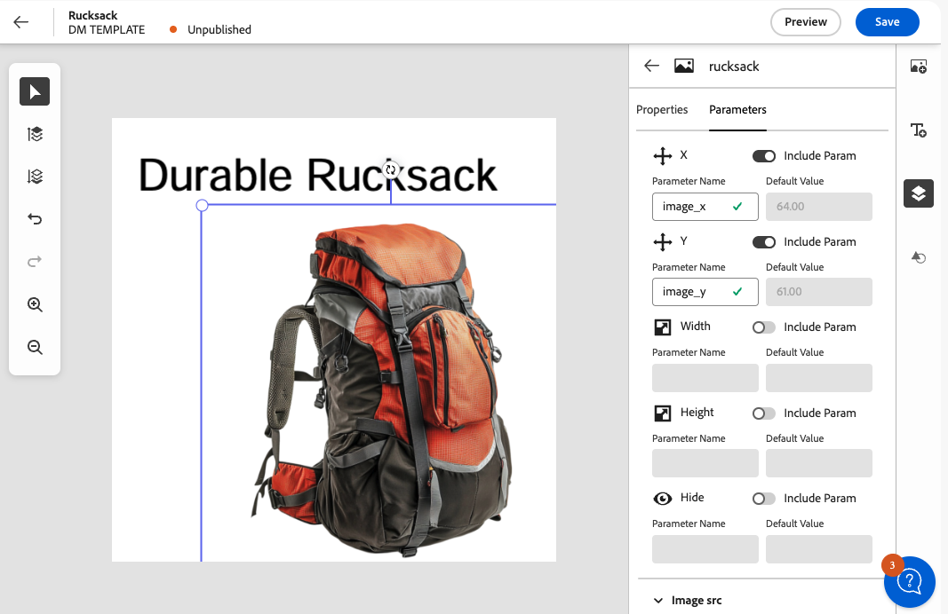
Dynamic Media Templates
Enable brand-consistent asset variations at scale
Templates link artwork with dynamic text, colors, or imagery
Users generate on-brand renditions without creative tools
Parameters controlled in AEM (no file editing required)
Streamlined for campaigns, regionalization, personalization
Notes:
Dynamic Media Templates are a capability exclusive to Assets View. You won’t find them in the classic Admin interface.
They allow organizations to scale creative output while maintaining brand consistency. A designer creates a master template once, linking certain elements—like text fields, colors, or image slots—to dynamic parameters.
Business users can then open the template in Assets View and generate their own on-brand variations. For example, a marketer can swap in new product shots, update a headline, or localize text for a region, all without touching Photoshop or Illustrator.
Because parameters are controlled in AEM, users can only edit what the designer intended. Fonts, layouts, and brand rules stay locked, so the output remains consistent while still supporting personalization and localization.
This dramatically reduces turnaround time for campaigns and ensures every asset variation stays on brand—at scale.
We won't go deeper in to templates today, and the takeaway for power users is just that the new feature is available in Assets View.

Slide 20
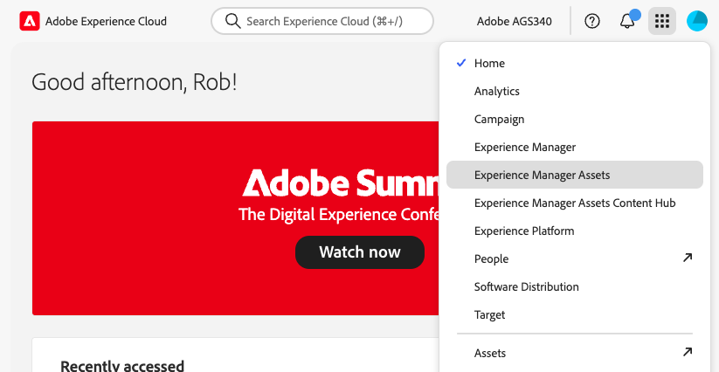
Navigate to Assets View
-> Asset View
Legacy - don’t use

Slide 21
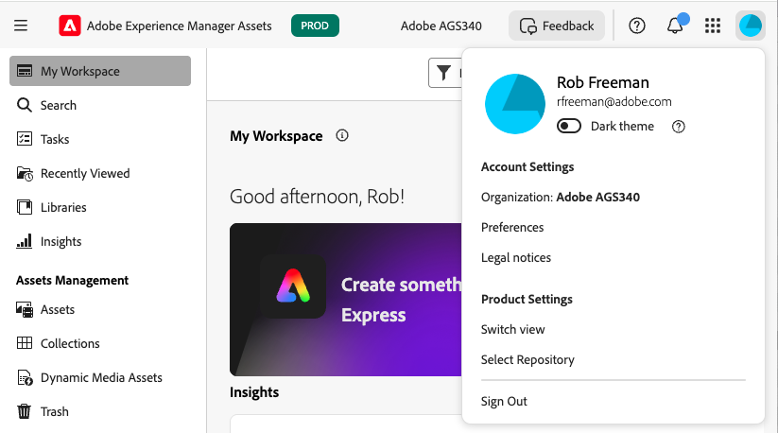
Switch between Admin and Assets View
To Admin View (and back)
Dev/stage/prod/preview

Slide 22

Access the Experience Cloud
Navigate to experience.adobe.com in a clean browser (incognito window)
Login using credentials from instructor
If asked to choose an organisation, choose vlab17-emea. Check again after login
Follow the instructions in the PDF guide: Workbook_Assets_Power_User_Update__Assets_View.pdf

Slide 23
Activity 1.1 – Assets View Core Functionality
Try out the UI
Complete simple upload
Edit image in Adobe Express
Use versions
Publish
Explore Dynamic Media renditions
Metadata first look

Slide 24
Instructor Demo

Slide 25
Activity Prep
Don’t complete an email / phone number!
Password: vL@bPa24

Slide 26
Metadata and Search
Notes:
Let’s talk about metadata management in AEM Assets, and how it works differently depending on which UI you’re using.

Slide 27

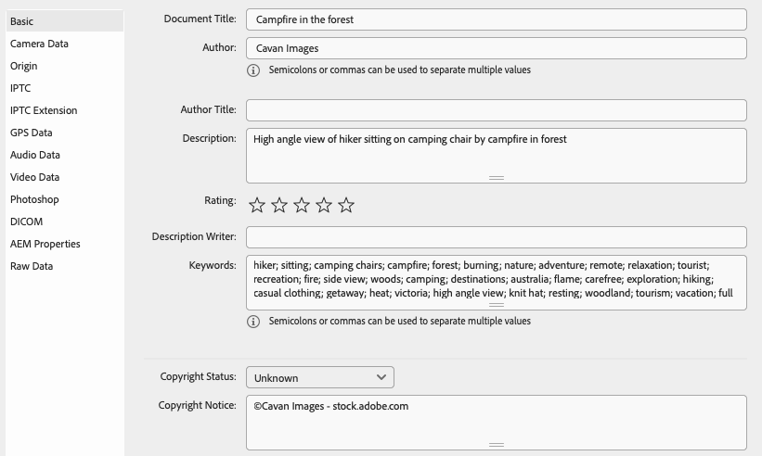
Metadata in AEM Assets: Two UIs, Two Systems
Same metadata extraction during image processing
Metadata management differs between Assets View and Admin View
Admin View uses Metadata Schemas, supporting power users, librarians etc
Assets View uses Metadata Forms, supporting simpler information for end users
Notes:
When assets are uploaded to AEM, metadata (such as XMP, IPTC, EXIF properties) is automatically extracted and stored in the repository, regardless of the interface used. However, the way metadata is viewed, managed, and edited differs depending on whether you use Assets View or Admin View.
Assets View displays and edits metadata through Metadata Forms—simple, user-friendly forms that control which fields appear in the Asset Details panel.
Admin View relies on robust Metadata Schemas, which offer administrators granular control over the metadata layout, field requirements, validation, and mapping in the Asset Properties dialog.
The underlying metadata is the same, but each UI provides a different way to manage and present this information.
Let's look in a bit more detail at both systems starting with Admin View.

Slide 28
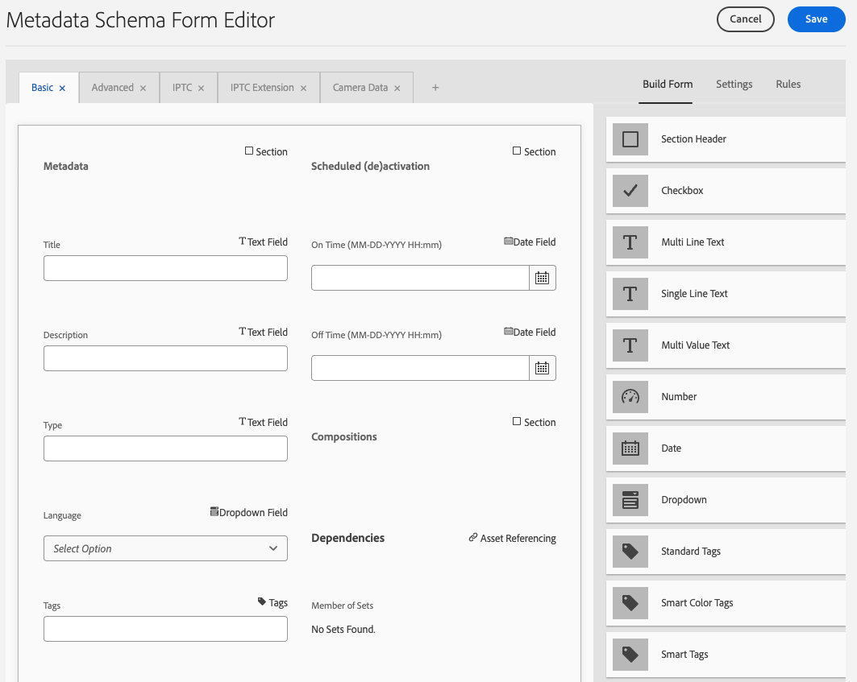

Admin View: Metadata Schemas
Configure in Schema Editor (Tools > Assets > Metadata Schemas)
Full control over visible, required fields
Set validation rules and layouts
Apply by file type or folder
Maps metadata to repository
Admin permissions required
Notes:
In Admin View, we use Metadata Schemas to control asset metadata.
The screenshot shows a metadata schema being configured by an administrator for the basic tab of an asset metadata dialog.
The admin can decide which fields are shown or required, add validation, and set layouts.
Schemas can be set for specific file types or folders and map metadata into the system.
All of this requires admin access, although some organizations may prefer this sort of configuration to be done by developers in your codebase.

Slide 29
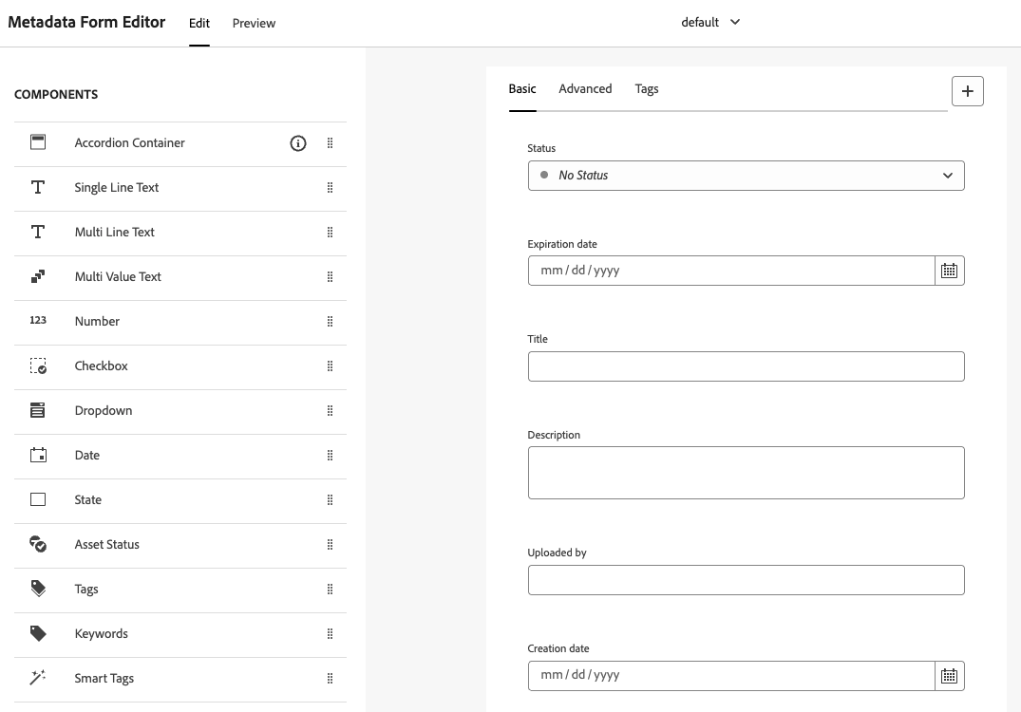
Assets View: Metadata Forms
Simple setup in visual editor
Controls fields on Asset Details page
Limited layout & validation options
Assign by MIME type or folder (new!)
Default forms shown unless customized
Easier for most users
Notes:
Assets View uses Metadata Forms—these are easier to set up and edit, but have fewer options.
They control which fields appear for each file type or folder on asset detail pages.
You can’t add detailed validation or customize layouts much.
By default, users see the standard templates, but forms can now be assigned by folder for more flexibility.
Note that you have no access to the Assets View forms configuration other than through the UI. These cannot be persisted in the codebase.

Slide 30
Schemas vs Forms: Key Differences (September 2025)
 | Admin View (Touch UI) | Assets View
Layout | Full control: tabs, groups, layout | Limited layout: Basic/Advanced tabs only
Validation | ✅ Yes: required fields, regex, rules | ❌ No required fields, regex, or rules
Mapping | ✅ Yes: full JCR property mapping (e.g., dc:title) | ✅ asset properties only; no custom paths (custom / arbitrary metadata)
Targeting | MIME type + folder path, with inheritance | MIME type or folder path, but only one form applies (overwrites)
Merge | ✅ Yes – schemas can merge from multiple folder levels | ❌ No merge – folder-level form replaces MIME-type form
Access | Admins only (via Tools > Assets > Metadata Schemas) | Power users via Settings or Folder Properties
Notes:
THere’s a summary comparing the configuration of access to metadata in the two views, Admin View and Assets View.
I won't attempt read through the slide, but will give you some time to read through.
-- pause --
We will come to a hands-on exercise shortly, and when we do that, you may want to use this slide as a reference if you have doubts about the differences. Also it may be useful to you in the future.

Slide 31
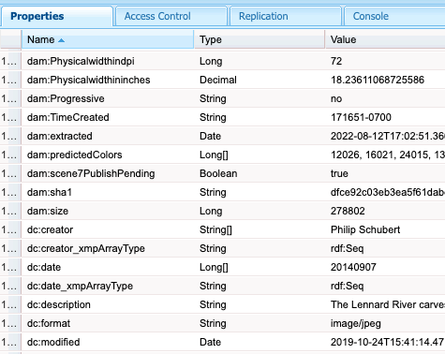
Metadata storage
Metadata is stored in the content repository (JCR)
UI just filters what is shown to users
Upload method doesn’t affect the stored metadata
Notes:
Regardless of which UI you use, all metadata actually lives in the same place: the AEM content repository, or JCR.
What you see in either Assets View or Admin View is really just a filtered view—a presentation layer.
No matter how an asset is uploaded—via Assets View, Admin View, an API, or integration—the metadata is written into the JCR.
So, if a metadata field doesn’t appear in your UI, it may still exist in the repository; it’s just not currently exposed in that view.
Understanding this is crucial for troubleshooting and for effective governance—UI configuration changes only affect what’s visible or editable to end users, not what’s stored behind the scenes.
Put another way - there is no synchronoization mechanism of metadate between systems as there is no need. The metadata values are the same.

Slide 32
Importing Schemas to Forms
Schemas from Admin View can be imported into Assets View
Resulting form is disconnected from original schema
No live sync or merge; imported form must be maintained separately
Notes:
A really helpful feature for organizations migrating to Assets View is the ability to import metadata schemas from Admin View and convert them into forms for use in Assets View.
This can smooth the transition between old and new interfaces and help maintain consistency, but it’s important to note that the imported form is disconnected from the original schema — there’s no ongoing sync or merge.
If you make changes to the source schema in Admin View, those changes will not automatically show up in the Assets View form.
Also, be mindful that importing a schema as a form called “default” will override the global form for all assets, unless there’s a specific MIME-type match.
So, use the import tool to accelerate adoption, but remember: maintenance and governance for imported forms is a separate, ongoing responsibility.

Slide 33
Exercise 1.2: Explore Metadata Changes
Use Switch View to access Admin View
Open the same asset, inspect metadata via Properties
Compare with what was shown in Assets View

Slide 34
Exercise 1.3: Understand Metadata Forms
Create a new metadata form based on a template (existing form)
Apply the new form to your training assets folder
Access the Metadata schema import tool

Slide 35
Quiz: Does the Assets View metadata form apply?
Form Name | MIME Type | Applies?
pdf | application/pdf | ?
image | image/png | ?
docx | application/msword | ?
default | application/json | ?
Notes:
Form Name MIME Type Applies?
pdf application/pdf ✔ Yes
image image/png ✔ Yes
docx application/msword ✘ No
default application/json ✔ Yes (fallback)

Slide 36
Metadata Usage
Role | Best Interface | Typical Task
Administrator / librarian | Admin View | Designing and enforcing metadata standards, inheritance, complex rules, packaging for deployment
End User/Marketer | Assets View | Searching, editing, viewing basic metadata, bulk updates, campaign tagging
Notes:
Here are two examples of user roles and their use of metadata.
We have a power user - administrator or librarian - who really needs access to fine detail about an asset. He or she would normally make use of metadata in the Admin View UI, with the configuration of the detailed information implemented by metadata schemas.
Then an end user such as a marketer. He or she normally uses the new Assets View UI and may need only need to use a limited set of metadata that will have been filtered to requirements using the Assets View metadata forms.

Slide 37
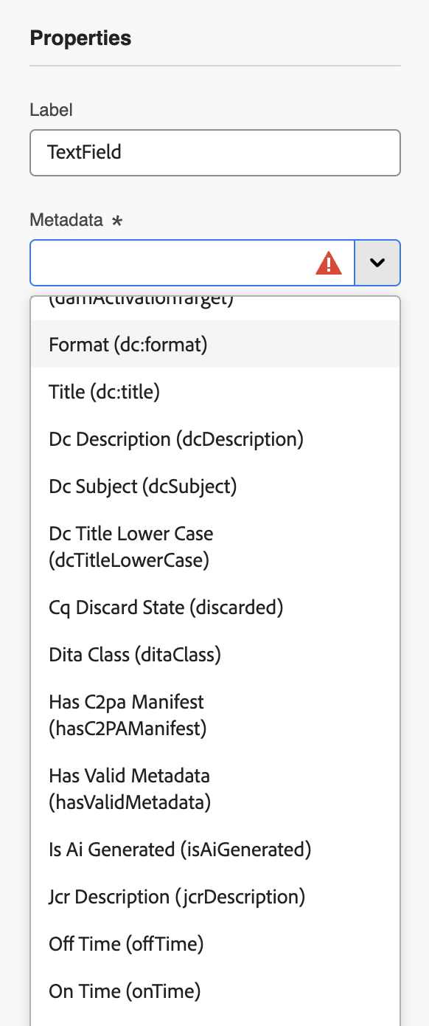
Search Capabilities – Assets View
Assets View search supports powerful features such as fuzzy search, boolean search, proximity, wild card, and suggestions.
Assets View supports contextual search: natural language input;
E.g., “images of mountains uploaded in the last month”
Assets View uses AI for ranking results
Notes:
Assets View provides a rich set of search capabilities for everyday users. Beyond simple keyword lookups, it supports fuzzy search, Boolean logic, proximity queries, and wildcards. This means that typos, variations in spelling, and more complex combinations of terms can still return meaningful results. Suggestions also help guide users toward common or likely matches as they type.
A newer capability in Assets View is contextual search, where natural language input is translated into filters and search criteria automatically. For instance, a query such as “images of mountains uploaded in the last month” will create the appropriate search filters without the user needing to build a structured query.
What you cannot do in Assets View is introduce custom predicate-based searches, as these cannot be added in Metadata schemas. The old Admin View allows for highly specialized predicates and overlays, but this extensibility is not carried forward. Assets View balances power with simplicity, but at the cost of configurability.
Finally, Assets View applies AI-based ranking to search results, factoring in signals like smart tags and metadata relevance. This means results may be ordered differently than in Admin View, with AI prioritizing what it deems the most relevant to the user’s query.

Slide 38
Exercise 1.4: Explore Search Features
Access search settings
Understand search filter configuration
Test drive contextual search

Slide 39
Instructor Demo - Search
Search filters and available metadata

Slide 40
Metadata and Search Summary
Assets View uses forms, Admin View uses schemas
Forms and schemas are UI filters, not data stores
Same metadata exists in the repository regardless of UI
Search in Assets View is different to Admin View: more capable in some ways, less in others
Use the right tool for the right job

Slide 41
Access Control
Notes:
Let’s turn now to permissions management in AEM Assets, which works a bit differently depending on the interface you use.

Slide 42
Introduction to Permissions
Admin View and Assets View each offer permissions management directly in the UI.
Meta Data Driven Permissions break the link between content structure and ACLs – a major change for AEM
Assets View and Admin View share permissions, but caution and governance is needed
Notes:
. Both Admin View and Assets View provide ways to manage who can access, edit, or share assets—but there are key differences and new features to be aware of, especially for those used to traditional folder-based ACLs.
A major innovation in Assets particularly relevant to Assets View is Metadata Driven Permissions, or MDDP, which allows you to break the link between asset location and access—moving towards a model where access is determined by asset metadata, not just where something is stored.
The two UIs share an underlying permissions system of AEM's repository, but you need to use care and governance when using the access control features in the UIs, as we will see in the exercises.

Slide 43
Access Control Part 1 Metadata Driven Permissions
Notes:
Now let’s focus on metadata-driven permissions, a recent and innovative feature that’s changing how enterprise DAM administrators manage asset access, in both Assets and Admin View.

Slide 44
Introduction to Metadata-Driven Permissions
Enforces access control based on asset metadata values
Released in late 2024 (AEM as a Cloud Service only)
Works in both Assets View and Admin View
Notes:
MDDP enforces access control based on metadata, instead of the traditional content structure.
MDDP was released in late 2024 and currently available only for AEM as a Cloud Service, lets you define access rules based on metadata values set for each asset.
For example, you can specify that only assets with a certain status or category are visible to specific user groups, regardless of folder location.
MDDP works across both Admin View and Assets View, supporting a metadata-first approach to governance and facilitating more granular, automated control of digital content. Despite not being an Assets-View-only innovation, it's included on this course as it is an enabler for the metadata first approach that is core to Assets View.
It’s become a best practice for enterprise-scale DAM environments with complex approval workflows or distributed teams.

Slide 45
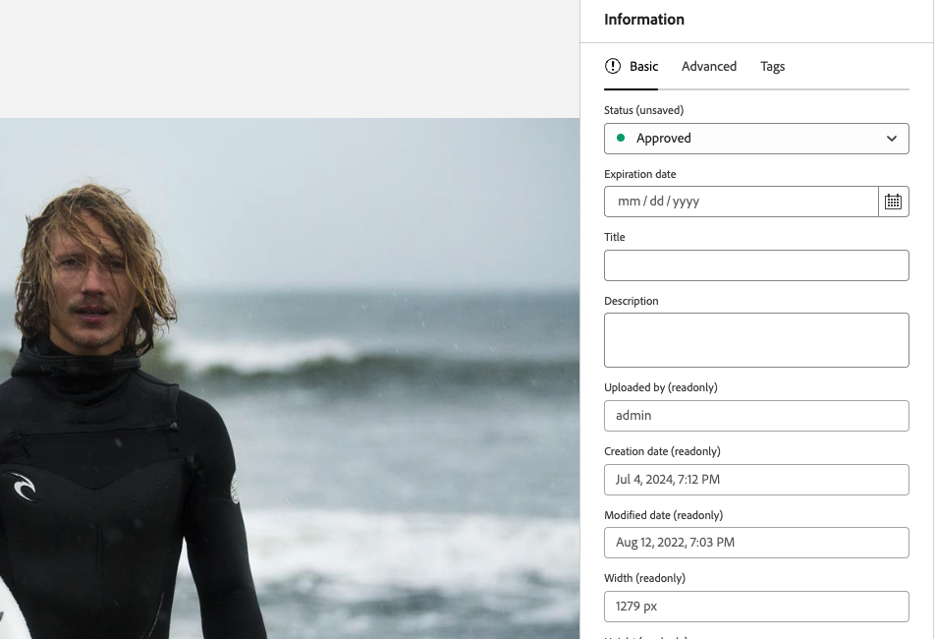
Use Case – Approved Asset Visibility
Objective: Show only approved assets to non-privileged users
Metadata field used: dam:status
Contributor group: only sees assets where dam:status = approved
All other assets are hidden, regardless of folder location
Notes:
Let’s walk through a practical example of how Metadata Driven Permissions (MDDP) can be applied.
Objective: Ensure that non-privileged users only see assets that have been formally approved.
Metadata field: Access is based on the value of the dam:status field.
Contributor group: Members of this group will see assets only when dam:status = approved.
Effect: Any asset without that value is automatically hidden from contributors, no matter which folder it resides in.
This setup provides a simple, reliable safeguard: unapproved content is never visible to general users, while approved materials remain easy to find and use.

Slide 46
Why Use Metadata Driven Permissions?
Supports business rules like “Only show approved assets to external users”
Enables automation-friendly governance
Reduces reliance on brittle folder-level ACLs
Improves scalability in large repositories
Notes:
Metadata-driven permissions go beyond a single scenario and unlock broader governance advantages:
Supports business rules – For example, “only show approved assets to external users,” or “limit region-specific content to local teams.” These rules are based on metadata values, not folder placement.
Enables automation-friendly governance – Because permissions follow metadata, they can be applied automatically as assets move through workflows, minimizing manual intervention.
Reduces reliance on brittle folder-level ACLs – Traditional access models tied to folder structures are hard to maintain at scale. MDDP decouples access from location, simplifying administration.
Improves scalability in large repositories – Permissions are evaluated at the point of access, making it easier to support thousands of users and millions of assets without rigid folder hierarchies.
Together, these benefits make MDDP a best practice for enterprise-scale DAM environments that need flexible, reliable, and future-proof governance.

Slide 47
Demo 2.1: Setting Metadata Driven Permissions
Add permissions for Contributors group:
Deny read access to the Magazine folder
Allow read where dam:status = approved
Login as contributor and verify
Assets with "approved" status are visible
Others are hidden
Notes:
As MDDP is set centrally for all users, we can’t do a hands on exercise on the same instance.
I’ll therefore demonstrated the configuration and effects of the system. The Demo is in the exercise book so you can follow through, but please DON’T DO IT on the training instance. We will…. (talk through slide)
- Add permissions for Contributors group:
- Deny read access to the Magazine folder
- Allow read where dam:status = approved
- Login as contributor and verify Assets with "approved" status are visible and Others are hidden

Slide 48
Access Control Part 2 Folder Permissions
Notes:
Move on to look at folder prmissions

Slide 49
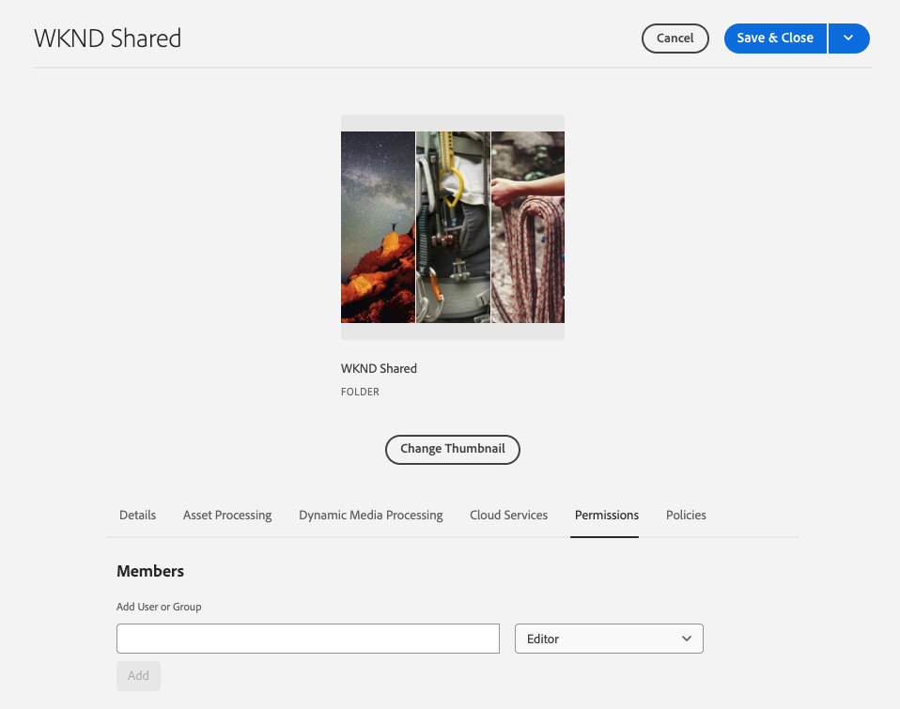
Admin View Folder Permissions (Touch UI)
Traditional AEM ACL-based permissions.
Folder-level permissions set via folder Properties > Permissions tab.
Assign basic roles directly: Owner, Viewer, Editor.
Simple UI.
Notes:
In Admin View, you can quickly set permissions directly from the folder’s Properties panel, using roles such as Viewer or Editor. This simplified model provides ease of management directly within the Assets interface itself.
The other AEM permissions related interfaces and capabilities are beyond the scope of this course – we will focus only on assets

Slide 50
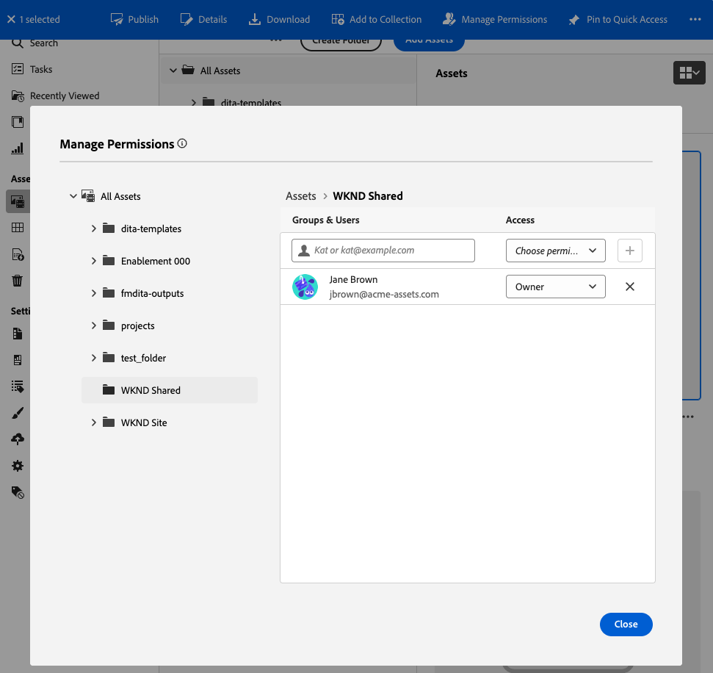
Assets View: Folder Permissions
Simplified permissions accessed via Manage Permissions in the toolbar.
Similar basic roles: Viewer, Editor, Owner.
Visually separate, yet permissions affect the same underlying ACLs as Admin View.
Notes:
Assets View similarly offers streamlined folder permissions directly accessible from the Assets toolbar.
Though visually different, it mirrors Admin View in simplicity and role assignment, both ultimately affecting the same permissions system.

Slide 51
Folder Permissions - Reliability and Governance Challenge
Admin View: Hides inherited or existing ACLs from Assets UI.
Assets View: Hides inherited or existing ACLs from Admin UI.
I.e. Edits from one view aren’t visually reflected in the other.
But: they are both effective (AEM will merge and calculate effective permissions).
ACLs edited in the UI are not persisted and versioned in the codebase, not part of a development/testing lifecycle and not copied to non-production environments (all unless specifically resolved through custom implementation/process).
! Use either Admin View or Assets View folder permissions (not both) or consider avoiding ACL management in the UI altogether. .
Notes:
Admin View and Assets View in AEM offer similar permission management features, but each UI hides inherited or existing ACLs set with the other.
Changes made in one UI are not visually reflected in the other, even though both models ultimately apply and merge permissions at the repository level (effective permissions are calculated by AEM behind the scenes).
Editing folder permissions using both views can create governance confusion, since users from each interface are blind to the changes made via the other.
Example: An “Allow” rule set in Admin View will not show up as an explicit permission in Assets View, but is still effective.
Choose one UI and stick with it for all permission editing.
Mixing will lead to lack of clarity and operational risk.
Finally, note that UI-edited ACLs are not stored in source control and will not be versioned or replicated between environments by default.
This breaks standard development and QA flows, unless custom code/processes are implemented to package and move ACLs between environments.

Slide 52
Activity 2.2: Folder Permissions Management
Manage Permissions in Assets View
Grant user “Can Edit” role
Check permissions in Admin View
Management permissions in Admin View
Check permissions in Assets View
Observations
Notes:
This exercise shows how both UIs can affect the same folder, but don’t always reflect each other’s changes. It drives home why consistency and governance are critical.

Slide 53
Access Control in AEM Assets – Key Takeaways
Metadata-Driven Permissions use metadata values like dam:status to restrict asset access.
Folder-level ACLs can be applied from both Admin View (detailed) and Assets View (simplified).
Both UIs write to the same JCR ACLs—but visual changes do not sync between UIs..
To avoid conflicts, always manage each folder’s ACLs in only one UI.
Apply MDDP with developer oversight and avoid overlapping ACLs and Metadata rules.
Consider avoiding folder permission management in the UI tools of both Assets and Admin Views.

Slide 54
Quiz: Access Control in AEM Assets
What does the Metadata Driven Permissions system use to determine access? A. Folder name B. MIME type C. Metadata field values
Can Assets View permissions override Admin View ACLs? A. No, they can conflict but no clean override B. Yes, they edit the same underlying ACLs C. Only if the user is an admin
Notes:
What does MDDP use to determine access? A. Folder name B. MIME type C. Metadata field values ✅ Correct Answer: C
Can Assets View permissions override Admin View ACLs? A. No, they are completely separate B. Yes, they edit the same underlying ACLs C. Only if the user is an admin ✅ Correct Answer: B

Slide 55
Customization
Notes:
Welcome to this section on UI customization in the new Assets View.
This is one of the more technical and evolving parts of AEM Assets, and it’s where the line between configuration and development becomes really important.
Today, we’ll explore what you can and can’t change, and where extensibility options come in.

Slide 56
Extensibility Overview
New extensibility options using the Assets View’s React-based framework allow for agile, modern integrations.
App Builder Extensions: Developers can inject custom panels, actions, and asset detail overlays using Adobe App Builder
UI Customization: Some UI components (e.g., widgets, overlays) can be extended using APIs.
Workspace Integration: More integration points with Adobe Workfront, Express, and future Content Hub.
Notes:
Let’s explore how the new Assets View opens up extensibility options for power users and developers.
- Because the UI is built on a React-based framework, extensibility is now more agile and modern compared to traditional AEM customization.
- One of the key updates is the introduction of App Builder Extensions. With Adobe App Builder and the UI Extensibility SDK, developers can inject custom panels, actions, and even overlays directly into the Assets View.
- Some elements of the UI—such as widgets and overlays—can also be extended or customized via APIs, giving teams more flexibility for tailored user experiences.
- Integration with Adobe Workfront, Adobe Express, and eventually Content Hub is becoming deeper, through new workspace integration points, supporting truly connected content workflows.
Overall, these extensibility features let organizations adapt the DAM experience to their unique requirements—while staying within the guardrails of upgrade-safe, modular development.

Slide 57
Extensibility – Limitations and Challenges
Limitations:
No support for classic Granite overlays or admin-side plugins as in Touch UI.
Extension points are growing, but not feature-complete—customization may require hybrid approaches referencing both UIs.
No bulk workflow triggers/extensions as of now.
Challenge: Custom Admin View extensions and customizations may need to be rebuilt for Assets View, or may not be currently possible (work with Adobe to overcome!)
Notes:
It’s important to recognize that while extensibility in Assets View is greatly improved, it also comes with new limitations and a few ongoing challenges.
First, the classic Granite overlays and admin-side plugins that you might use in Touch UI or older AEM environments aren’t supported here—so legacy customizations must be rethought.
Extension points are growing quickly, but not every use case is yet covered. Some bespoke workflows may still require hybrid solutions, using both Admin View and the new Assets View APIs.
Currently, there’s also no support for bulk workflow triggers or extensions within the Assets View interface.
A major challenge for enterprise customers is that many older, custom plugins or overlays must be rebuilt from scratch using the new React-based APIs, and full feature parity between Admin View and the new UI is still evolving.
So, while Assets View enables faster and safer extensibility, there’s a real need to plan migrations, manage technical debt, and coordinate across teams as you modernize your asset management solutions.

Slide 58
2025 H2 Update
Increased extensibility endpoints
Action Bar
Asset Context Menus
Custom panel extensions
Integration Endpoints for External Systems

Slide 59
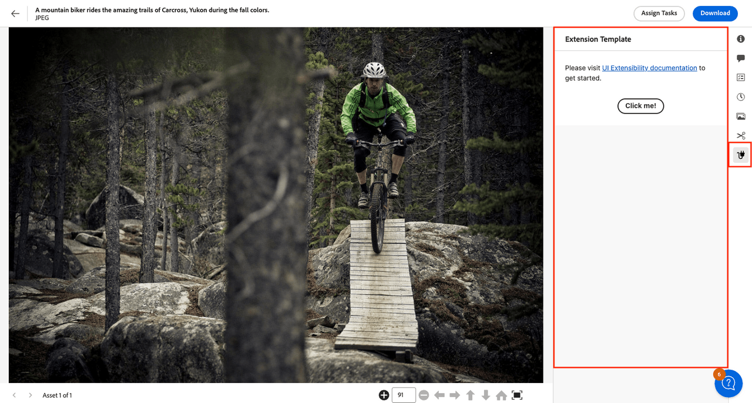
Use Case: "Download As" Panel
Custom panel in Details view
Users select format (JPEG, PNG), file size, DPI
Download button triggers Dynamic Media API
Built with App Builder and UI Extensibility SDK
Fully upgrade-safe and modular
Notes:
To illustrate what's possible with the extensibility options, let’s look at a recent real-world example: the “Download As” panel.
Many enterprise and marketing teams want the ability to download assets in specific file formats, sizes, or resolutions directly from the asset details screen. Out of the box, Assets View didn't support these advanced download options natively.
Using App Builder and the UI Extensibility SDK, our teams developed a custom panel that appears right within the asset’s detail view.
This panel allows users to select the desired file format—for example, JPEG or PNG—set the file size or DPI, and then trigger a download, all powered by the Dynamic Media APIs in the background.
It's fully modular and upgrade-safe, integrating seamlessly into the existing UI and respecting your site’s branding and theming.
This solution really highlights how the new extensibility framework allows you to deliver powerful, business-specific DAM tools while maintaining rapid upgrades and operational agility.

Slide 60
Key Takeaways
Assets View: config-focused, limited scope
UI Extensibility unlocks power—but needs Assets Ultimate
OOTB: rapid, light customizations
Notes:
Here are the key points for customizing Assets View:
- Assets View is designed for easy configuration with a limited set of options—most organizations can get started quickly, but there are boundaries to what’s possible out of the box.
- If you want advanced extensions or embedded custom panels, UI Extensibility unlocks significant power—but note that these capabilities require the Assets Ultimate license.
- For most teams, rapid, lightweight customizations—such as simple branding or small workflow tweaks—can be handled out of the box, without development.
- Finally, governance is critical. Extensions should be carefully planned and documented to ensure ongoing maintainability, compliance, and a seamless upgrade path.

Slide 61
Insights

Slide 62
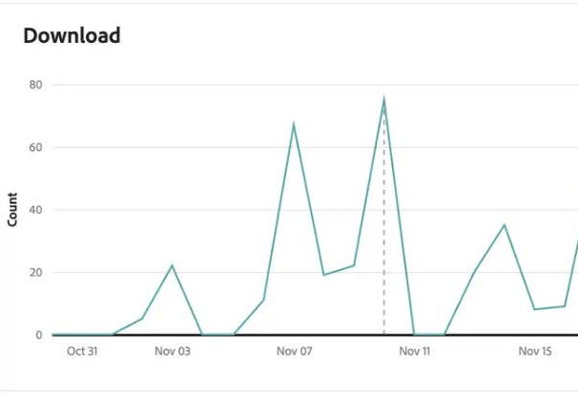
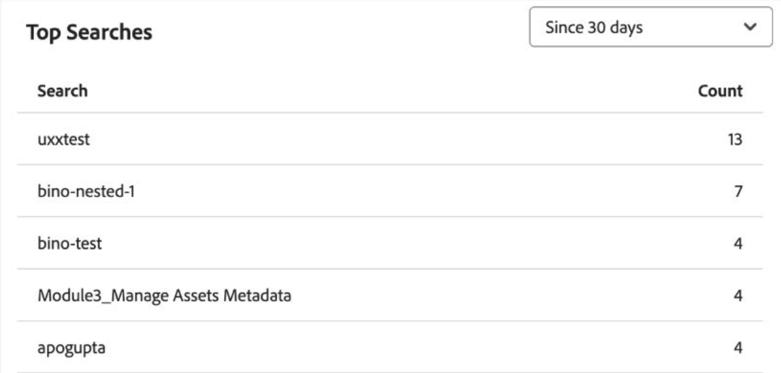
Insights
My Workspace: dashboard with recent activity/usage
Asset details: download count, last modified, etc.
Subscriptions: notifications for content updates
Insights: search trends and usage patterns
Features may evolve—check documentation for latest
Notes:
Assets View includes a range of in-context analytics and insights tools designed to help users and DAM managers understand how their content is being used.
The __My Workspace__ dashboard gives each user a snapshot of recent activity—such as uploads, downloads, search queries, and tasks. At the asset level, you’ll find basic usage metrics within the details panel, including downloads and recent changes.
Users can subscribe to folders or assets to receive notifications about updates, helping them track changes or activity that affects their work.
Additionally, Insights and trends panels in the UI surface information like popular search terms and general usage patterns over time.
These analytics capabilities are being expanded and refined all the time. For the most up-to-date details or specialized reporting, I recommend checking the official AEM documentation.

Slide 63
Insights – Limitations and Challenges
No custom analytics or report export in Assets View; use Admin View for advanced needs
No built-in tracking of asset usage on external sites—third-party integration required
Notes:
While Assets View offers helpful built-in insights, there are a few important limitations to be aware of.
First, custom analytics—such as configurable dashboards, downloadable reports, or extensive filtering—are not available within the Assets View UI. If your team needs advanced reporting or wants to export analytics, you’ll still need to use the classic Admin View or connect to external analytics tools.
Second, tracking asset usage on third-party platforms or customer-facing websites isn’t available out-of-the-box. This kind of external tracking is possible, but it requires separate integration work—embedding your own analytics code or using specialized tools outside of AEM.
For many teams, these constraints may not be an issue—but if you require complex reporting or external asset tracking, you’ll want to plan for additional setup or continue leveraging Admin View.

Slide 64
Key Course Takeaways
Assets View is a great addition to the AEM Assets ecosystem and evolving rapidly
Assets View promotes metadata/search-first design
The same underlying AEM repository and AEM asset processing is used for both Assets View and Admin view
Apply governance to permissions management if UI tools are used
Metadata UI configurations and application are different but complementary, suiting the target user groups
Assets View UI configuration and customization is limited compared with Admin View
Expect change!
Notes:
- Assets View is a great addition to the AEM Assets ecosystem and evolving rapidly
- The same AEM repository and AEM asset processing is used for both Assets and Admin view
- Governance and cautious use of permissions management are important
- Metadata features are significantly different to those in the Admin View
- UI Configuration is restricted compared with Admin View
- Expect change!

Slide 65
Key Takeaways and Questions

Slide 66

Questions?
Image by Ran Zheng
Notes:
TALK
Any final questions?

Slide 67
Closer Slide

